Slide 1
Visual Analytics of Movement Behavior Pattern Based on Time-Spatial Data: A Neural Net Approach
Presented by
Zhenghao Chen
Bachelor of Information Technology(Honors)

Slide 2
Background
Time Spatial Data
Format
Motivation
An efficient method to analyze this type of data and understand the embedded pattern
Challenge
Data Model
Feature Extraction Algorithm
Visual Display
Timestamp | x | y | Other Information
2015-06-06 10:00:01 | 43.2 | 56.3 | Check in location B

Slide 3
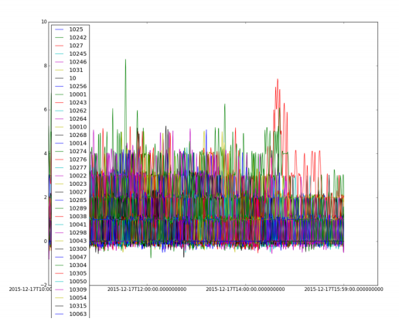
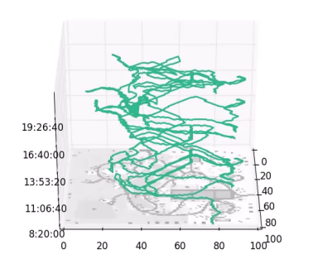
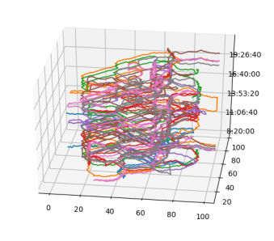
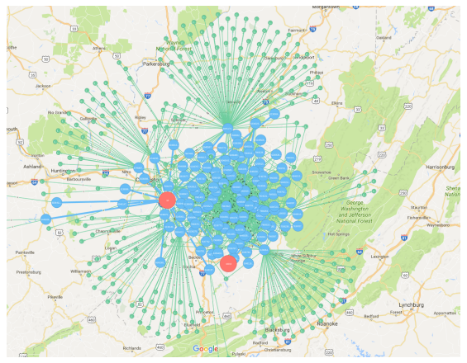
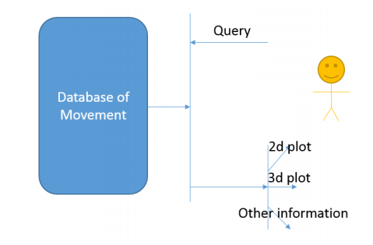
Literature
Conventional Methods
Visual Analytics System[1]
Architecture
Visual Display Methods
2D Map
3D Cube
Statistic
Feature Extraction[2][3]
Machine Learning
Classification
Clustering
Deep Learning[4]
Prediction

Slide 4
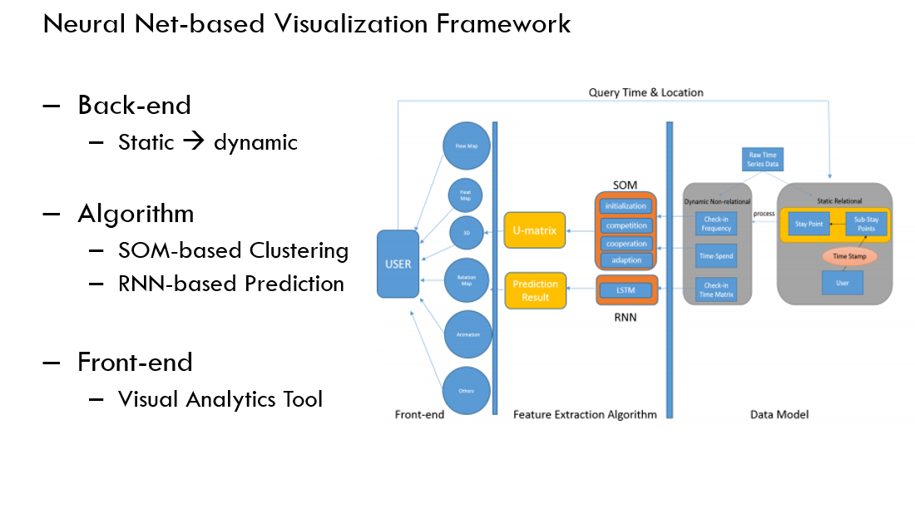
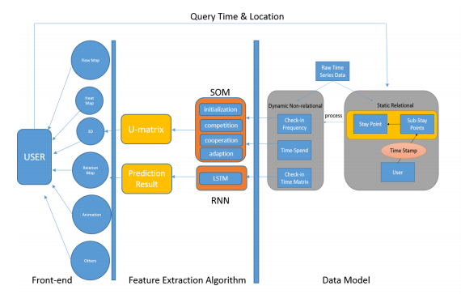
Our Method - Overview
Neural Net-based Visualization Framework
Back-end
Static → dynamic
Algorithm
SOM-based Clustering
RNN-based Prediction
Front-end
Visual Analytics Tool

Slide 5
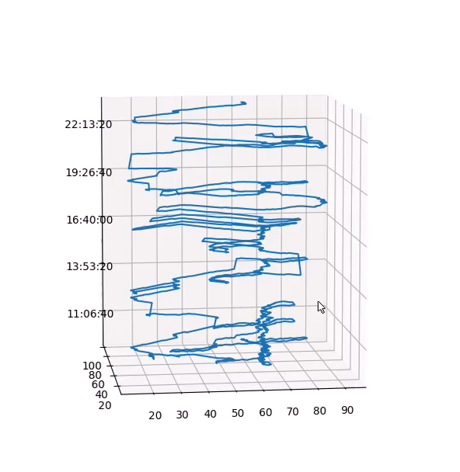

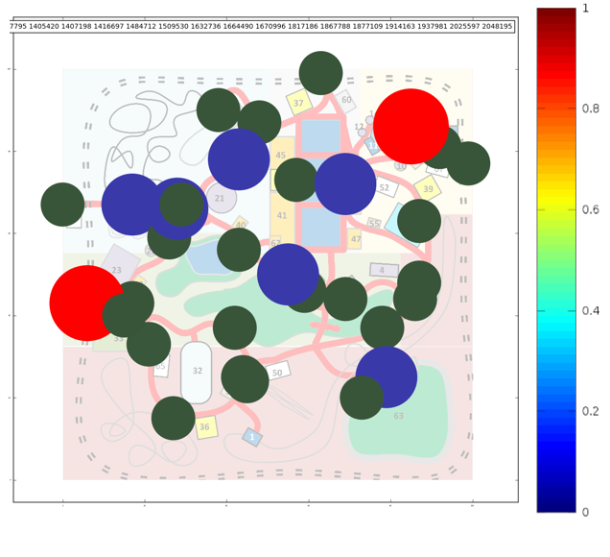
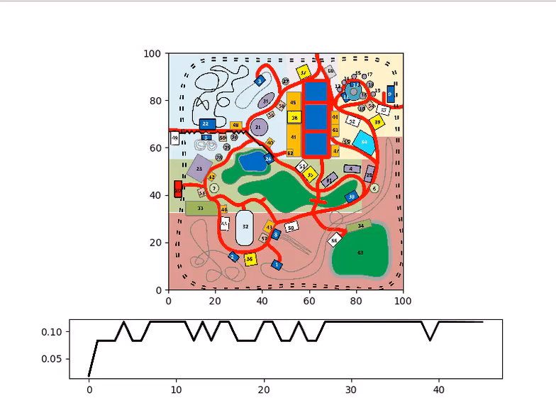
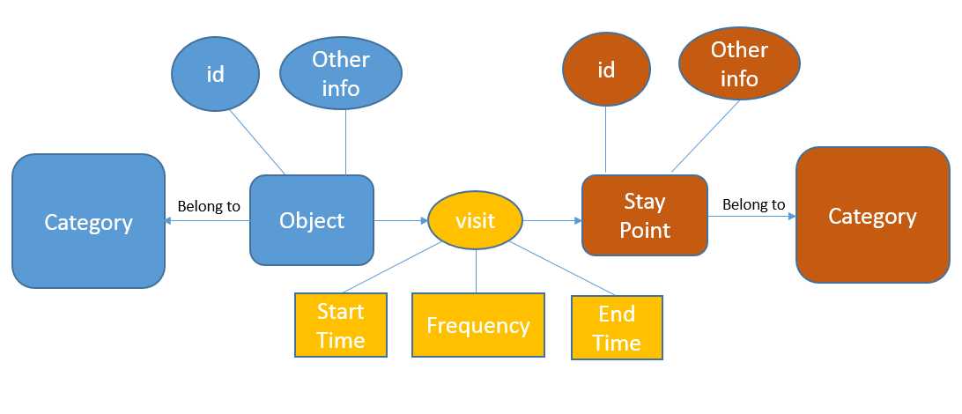
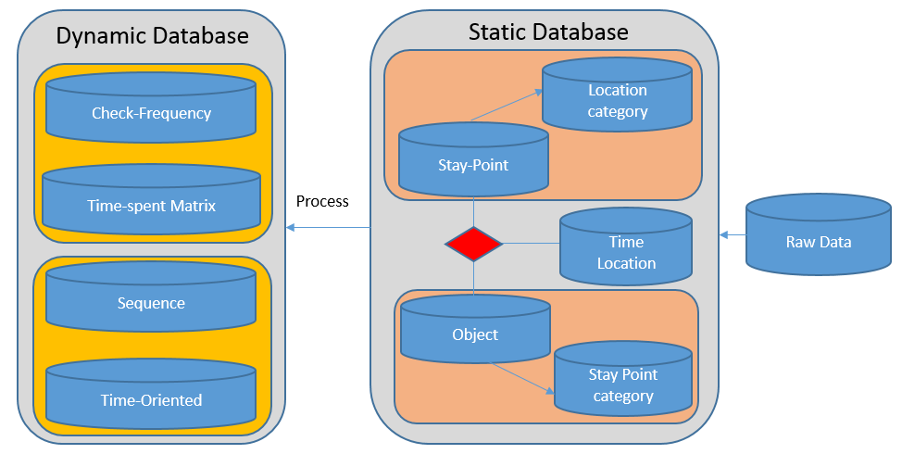
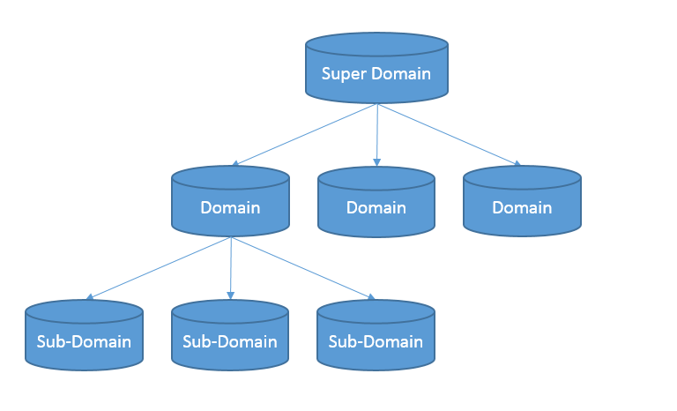
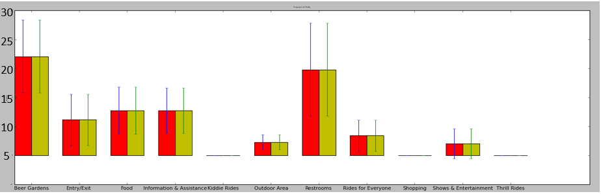
Our Method – A Static to Dynamic Data Model
A Static to Dynamic Data Model
Static Relational Data Model
Relationship
Tree Structure
Index
Dynamic Data Model
Time-spend Matrix
Check-in Frequency Matrix
Sequence Matrix
Time-oriented Vector

Slide 6
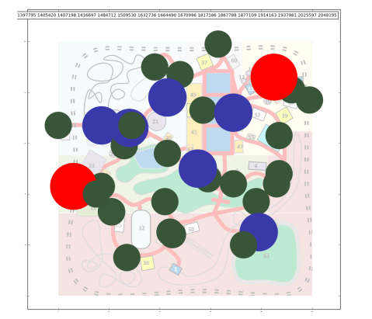
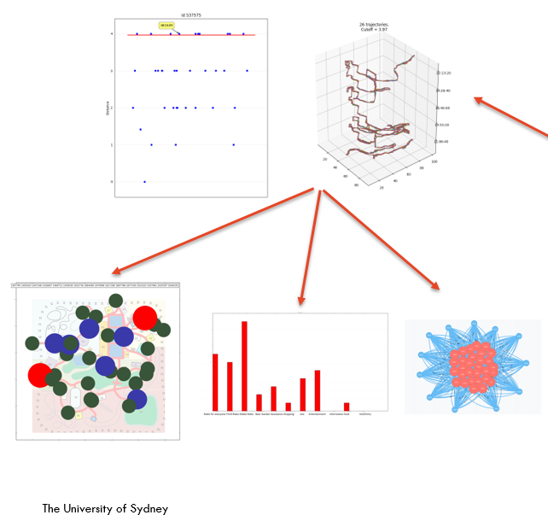
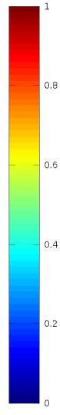
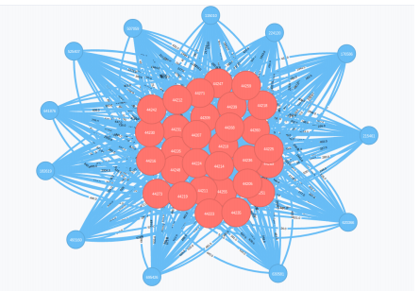
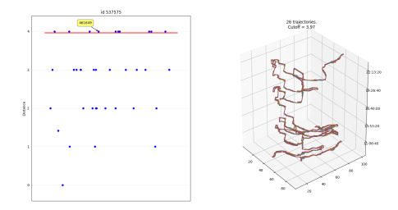
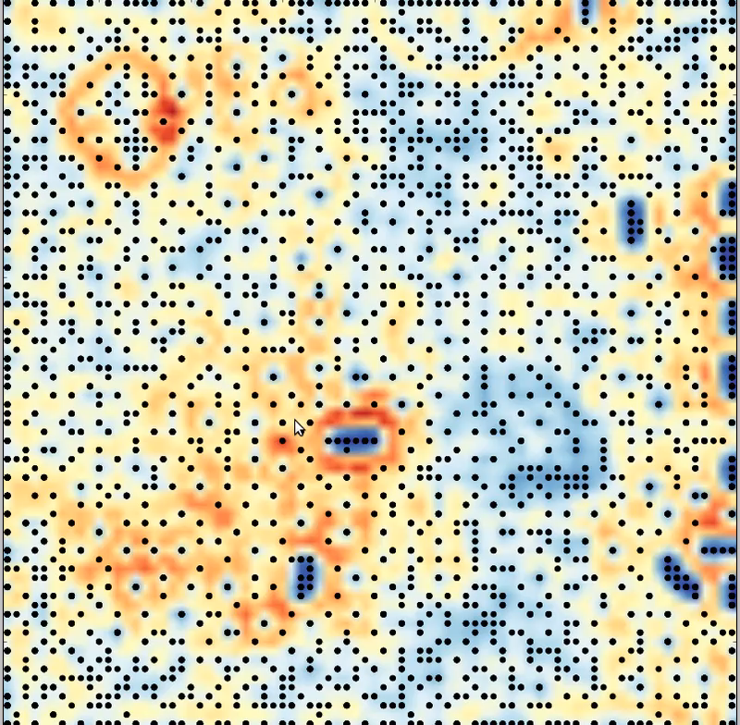
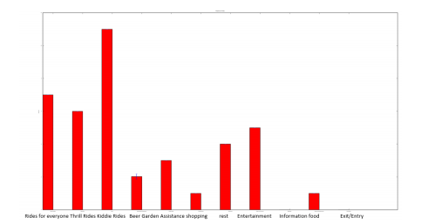
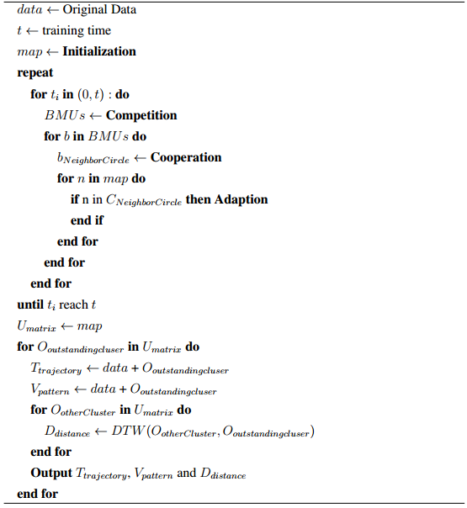
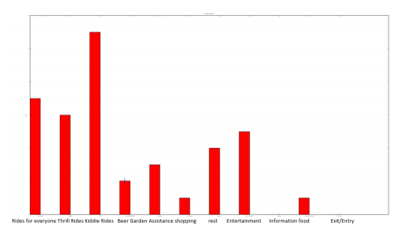
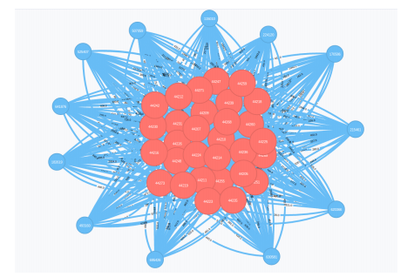
Our Method – Self-organizing Map based Clustering
Self-organizing Map Based Clustering
Algorithm[5]
Initialization
Competition
Cooperation
Adaption

Slide 7
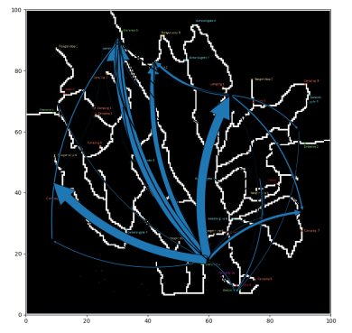
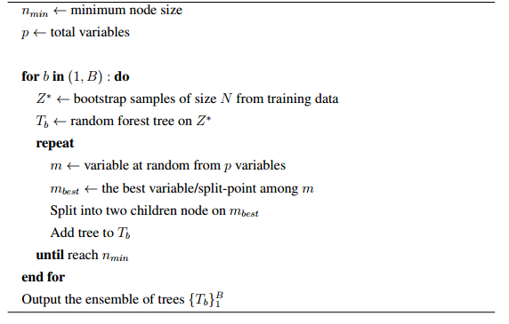
Our Method – Deep Learning based Prediction
Deep Learning-based Prediction
Classification Method
KNN
SVM
Decision Tree
Random Forest
Deep Learning-based Method
Recurrent Neural Net[6]
Long-short Term Memory

Slide 8
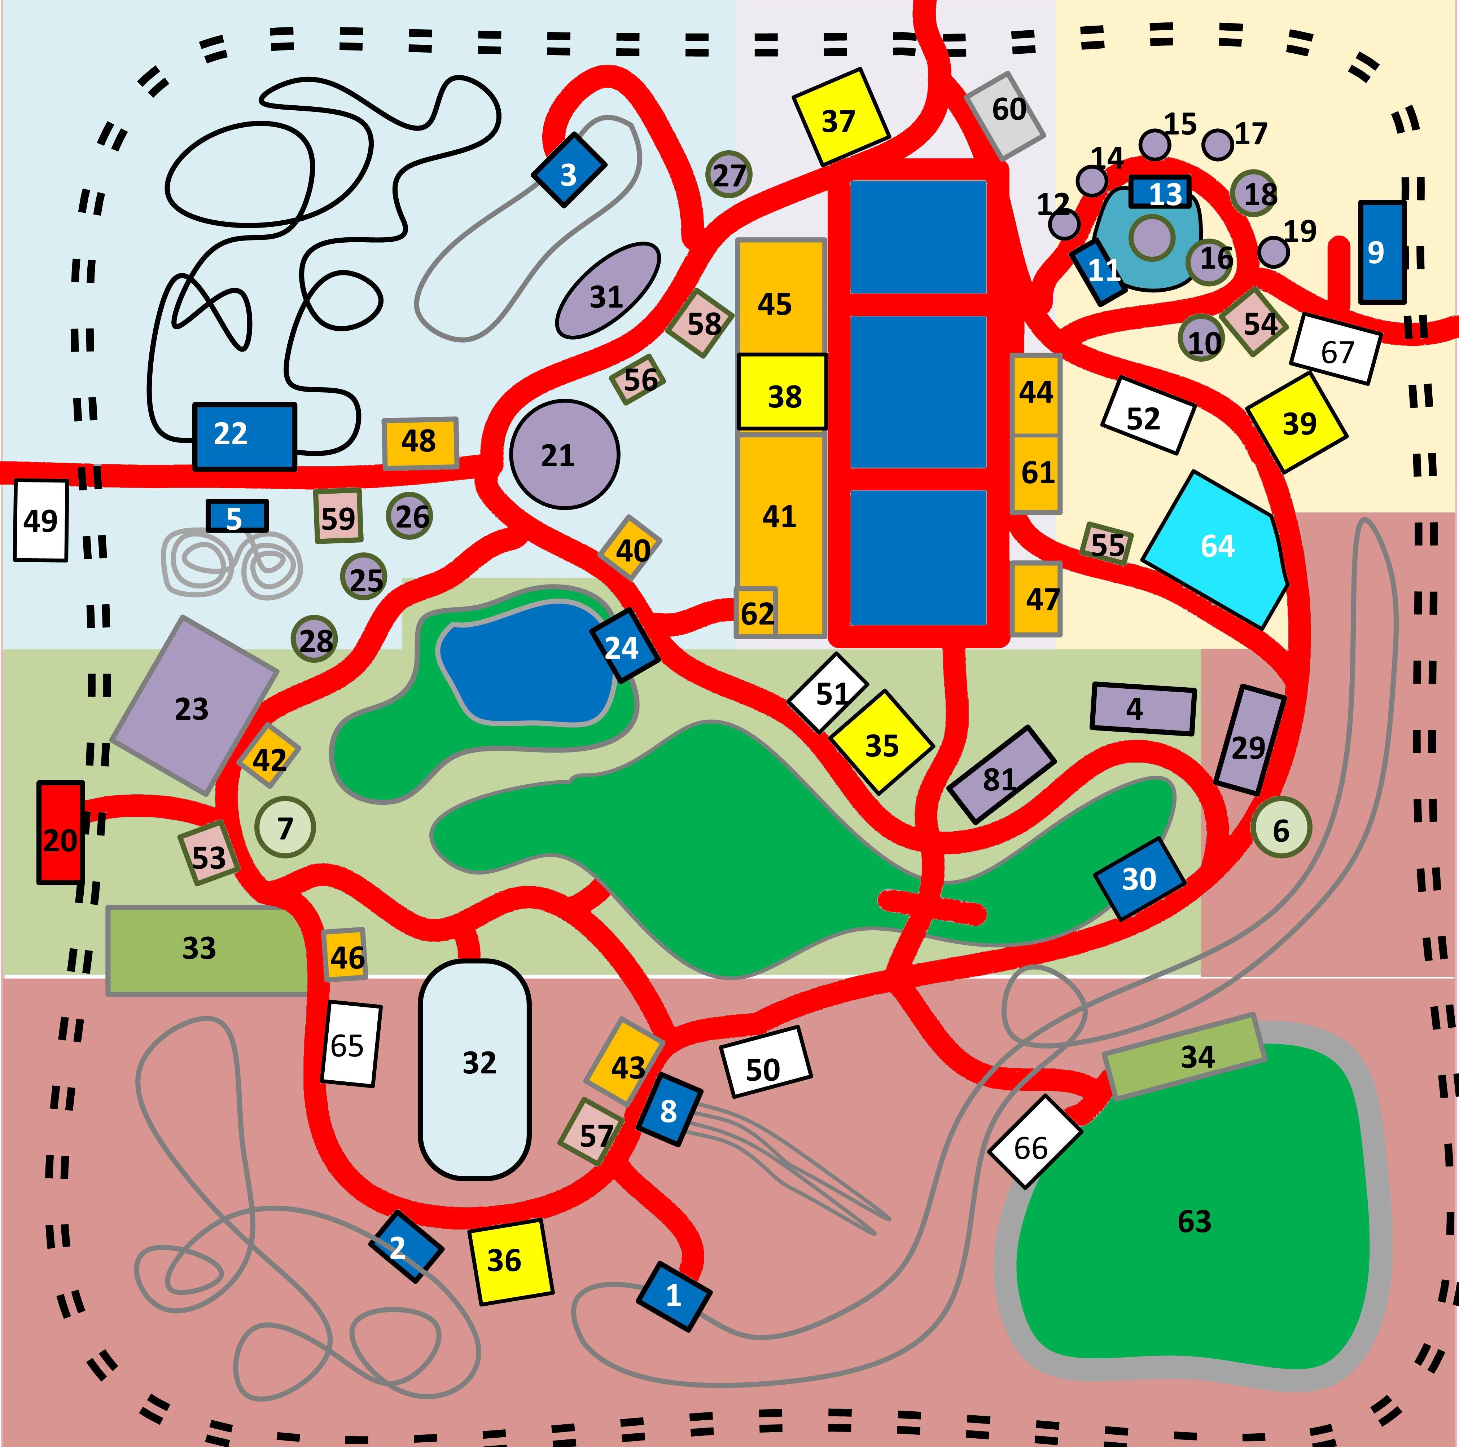
Experiment 1– Park Management
VAST Challenge 2015 Theme Park: Dino Fun World
Data Size
10 million sets day
3557 people on Friday, 6411 on Saturday, 7569 on Sunday.
Data Format
Task
Crime Occur on Sunday in Attraction 32
Give Suggestions for Park Management
Time Stamp | Visitor | (x,y) | Behavior
07-06-14 12:00:00 | 10801 | 23,40 | Check-in

Slide 9
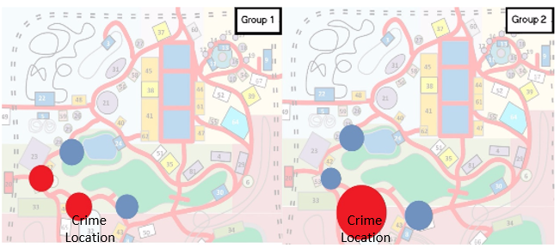
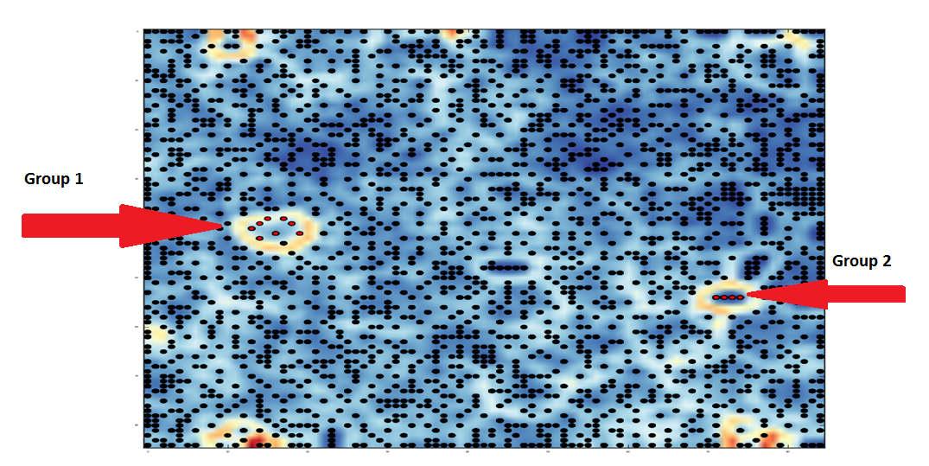
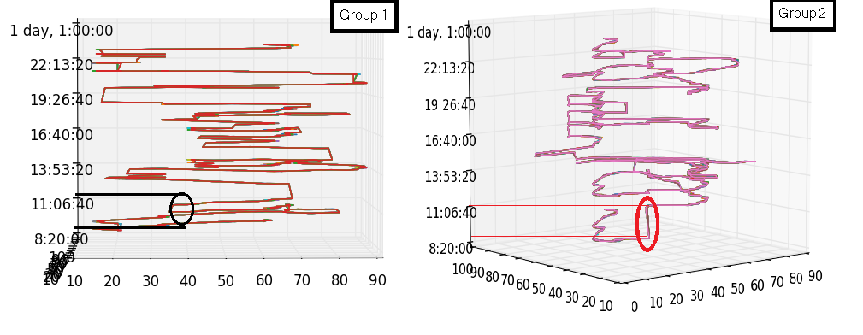
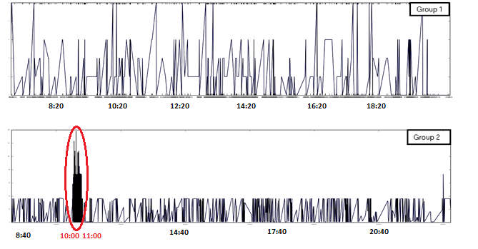
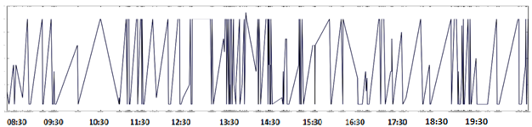
Experiment 1– Park Management
Crime Detection

Slide 10
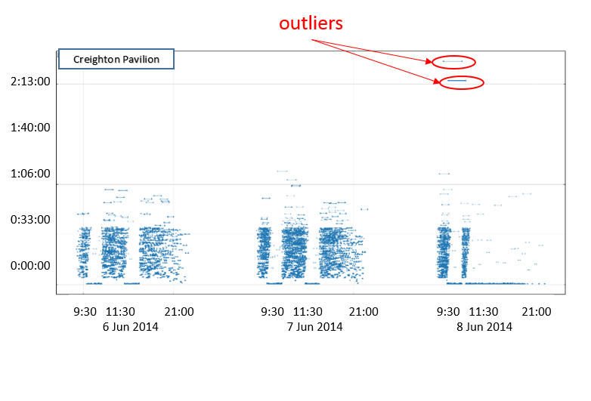
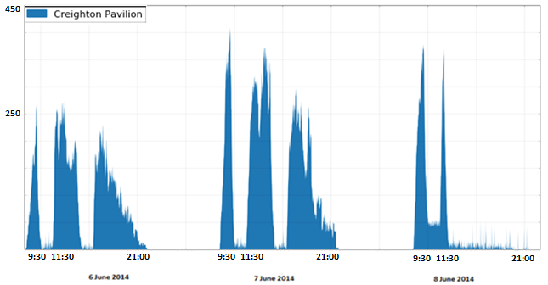
Experiment 1– Park Management
Crime Detection
Conclusion
Crime Time: 10:00 - 11:00
Group 2: commit crime
Group 1: assist crime

Slide 11
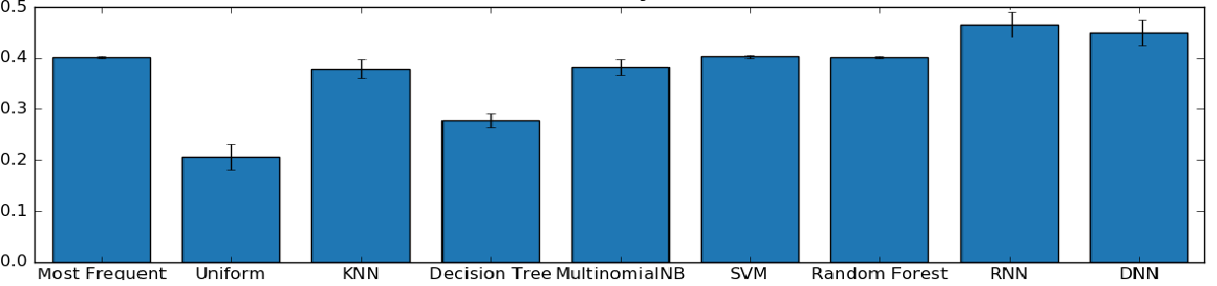
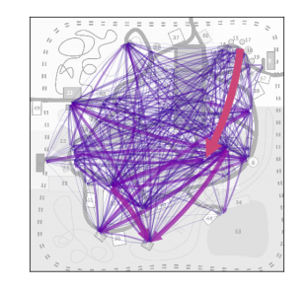
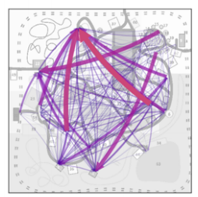
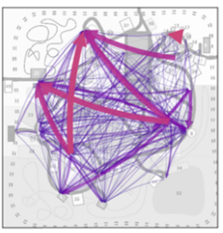
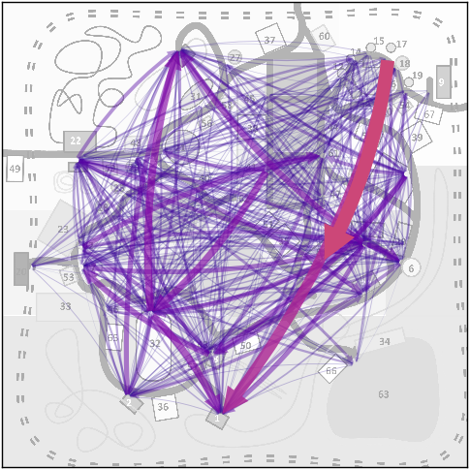
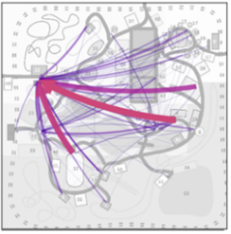
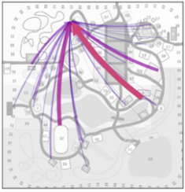
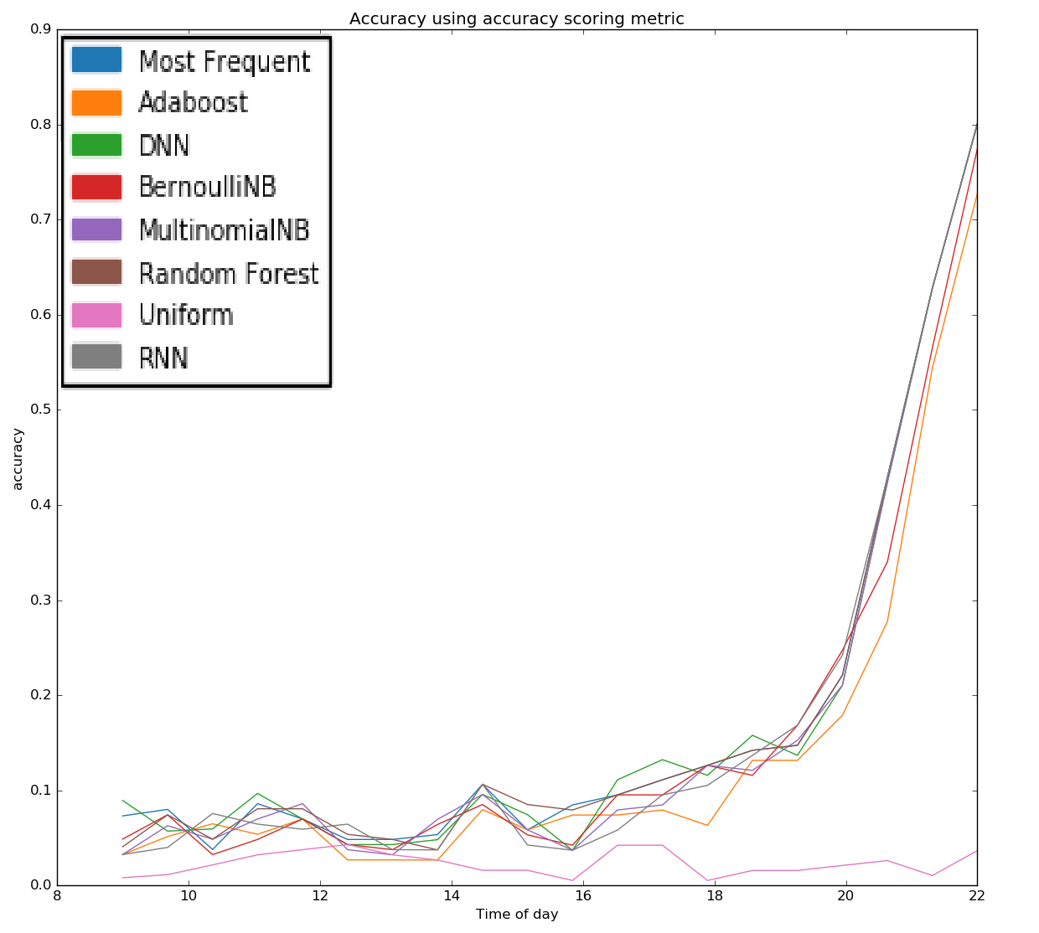
Experiment 1 – Park Management
Prediction Of Movement Flow
Evaluation
Visualization
RNN
Most Frequent
Naïve Bayes
Actual Movement
Random Forest
KNN

Slide 12
Experiment 2 – Commercial Promotion for Mobile User
Chinese Mobile Company Data
Data Format
Size of Data
Over millions user activated per day
Over 1000 stations
Over 1,000,000 IP visited per day
Motivation
Give advice for commercial promotion
Time Stamp | Geo-information | Station | IP
06-01-2015 10:00:00 | (x,y) | 10 | 10.00.79.523

Slide 13
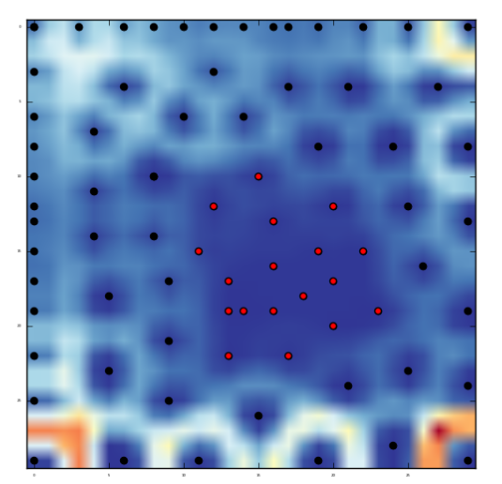
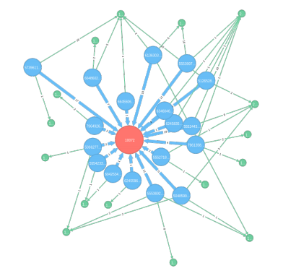
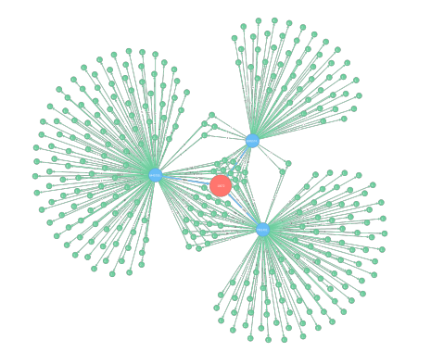
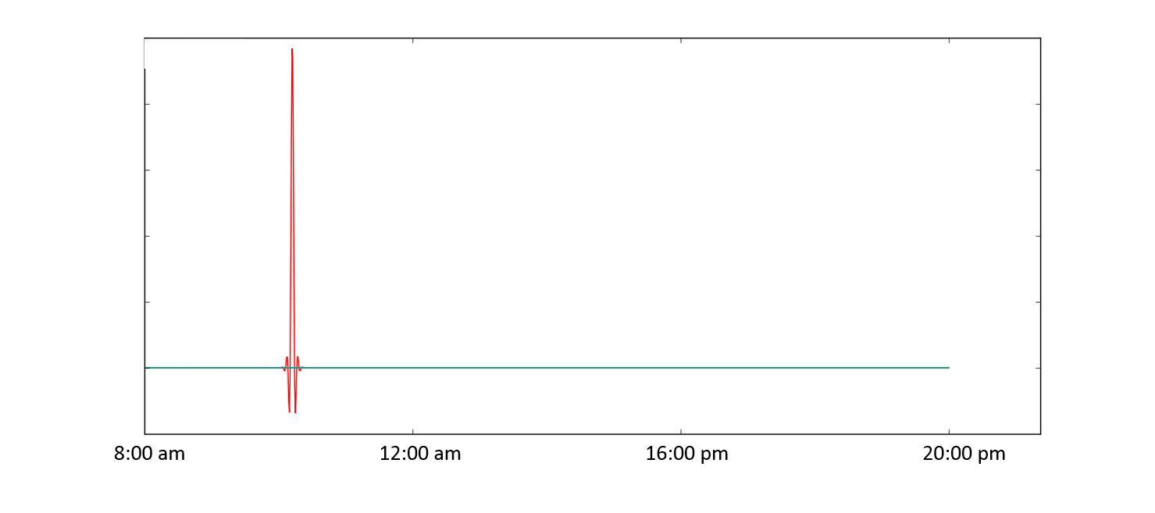
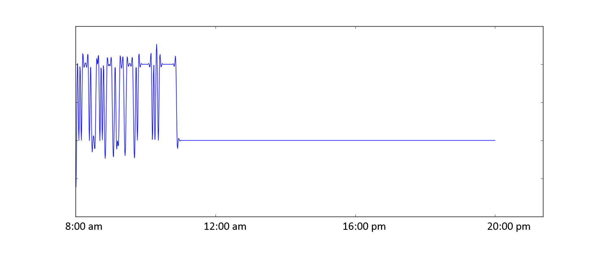
Experiment 2 – Commercial Promotion for Mobile User
Outstanding User Detection
Regular User
Outstanding User

Slide 14
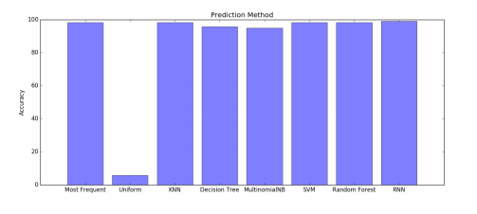
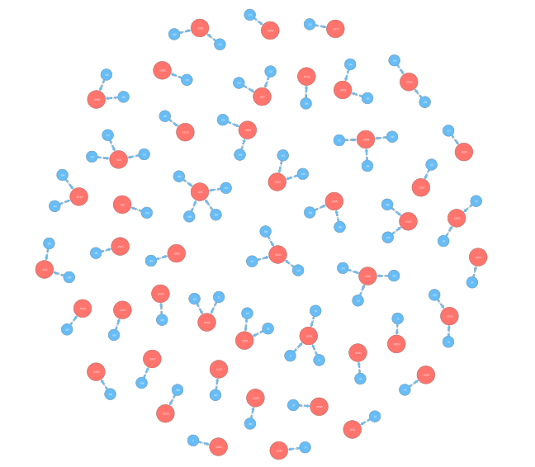
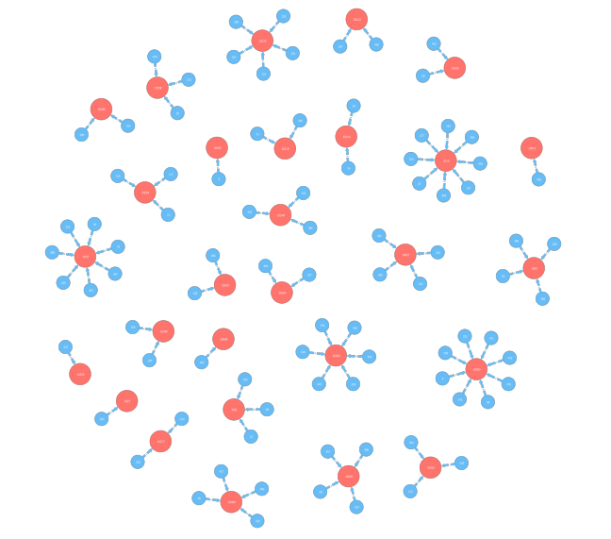

Experiment 2 – Commercial Promotion for Mobile User
Prediction Of Station Usage
Evaluation
Prediction Result
Actual Usage
Prediction Usage

Slide 15

Experiment 3 – Traffic Patterns in Nature Preserve
VAST Challenge 2017 Nature Preserve Boonsong Lekagul
Data Size
5 categories of location
6 types of vehicles
Over 100 millions trajectories data
Data Format
Motivation
Analyze abnormal pattern
Analyze affects on wildlife
Time Stamp | location | type
15-06-16 12:00:00 | Gate 1 | Large Truck

Slide 16







Experiment 3
Abnormal Pattern

Slide 17




Experiment 3 – Traffic Patterns in Nature Preserve
Regular Pattern

Slide 18








Experiment 3 – Traffic Patterns in Nature Preserve
Prediction
Evaluation
Visualization
KNN
Random Forest
RNN
Actual Movement
Most Frequent
SVM

Slide 19
Conclusion
• Set up a time-spatial data visual analytics pipeline to understand movement behavior
• Modify and utilize Artificial Neural Net approach to propose a clustering (SOM) and prediction (RNN)methodology
• Participate in two public challenges (VAST 2015 & VAST 2017) and provide suggestion to a Chinese Mobile Company

Slide 20
Publication
Conferences
[1] Zhenghao Chen, J. Zhou, X. Wang, J. Swanson, F. Chen, D. Feng “Neural Net Based and Safety-Oriented Visual Analytics for Time-Spatial Data” IEEE International Joint Conference on Neural Networks 2017 (IJCNN 2017)
[2] Zhenghao Chen, J. Zhou, X. Wang “Abnormal Trajectory Pattern Detection and Visualization using Neural Net” IEEE Visual Analytics Science and Technology 2017 (VAST 2017) Submitted
Journal
[1] Zhenghao Chen, J. Zhou, X. Wang, F. Chen, D. Feng, H. Cui “Visual Analytics of Movement Behavior Pattern Based on Time-Spatial Data: A Neural Net Approach” IEEE Transactions on Human-Machine Systems, Submitted

Slide 21


Acknowledgement
Thanks to Following Organizations and People
Dr Xiuying Wang (Supervisor) & Dr Jianlong Zhou (Co-supervisor)
The University of Sydney & CSIRO Data61

Slide 22
Reference
[1] Yu Zheng, Lizhu Zhang, Xing Xie, and Wei-Ying Ma, “Mining interesting locations and travel sequences from GPS trajectories,” in Proceedings of the 18th international conference on World wide web. ACM, 2009, pp. 791–800.
[2] Natalia Andrienko and Gennady Andrienko, “Visual analytics of movement: An overview of methods, tools and procedures,” Information Visualization, vol. 12, no. 1, pp. 3–24, 2013.
[3] Yu Zheng, “Trajectory data mining: an overview,” ACM Transactions on Intelligent Systems and Technology (TIST), vol. 6, no. 3, pp. 29, 2015.
[4] Qiang Liu, Shu Wu, Liang Wang, and Tieniu Tan, “Predicting the Next Location: A Recurrent Model with Spatial and Temporal Contexts.,” in AAAI, 2016, pp. 194–200.
[5] Teuvo Kohonen, “The self-organizing map,” Neurocomputing, vol. 21, no. 1, pp. 1–6, 1998.
[6] Yann LeCun, Yoshua Bengio, and Geoffrey Hinton, “Deep learning,” Nature, vol. 521, no. 7553, pp. 436–444, 2015.

Slide 23
Thank You Q & A

